Slide 1
Year 10
Remote Learning:
Product Design
Download this PowerPoint and work on it directly. When complete upload it to the correct Google Classroom (info. on next slide). Your teacher will award prizes next term for the best work.

Slide 2
Class Codes for Year 10
Technology & Design
Technology Class | Class Code
10-1 (Mrs Convery) | s7oxbee
10-2 (Mr. Kelly) | ztsxmwf
10-3 (Mrs Convery) | nfl5lhz
10-4 (Mr. Kelly) | xzgmawe
10CT (Mrs Convery) | rg4njo7
10RS (Mr. Mc Goldrick) | ligvguc
10CF (Mr. Kelly) | qjpujda

Slide 3
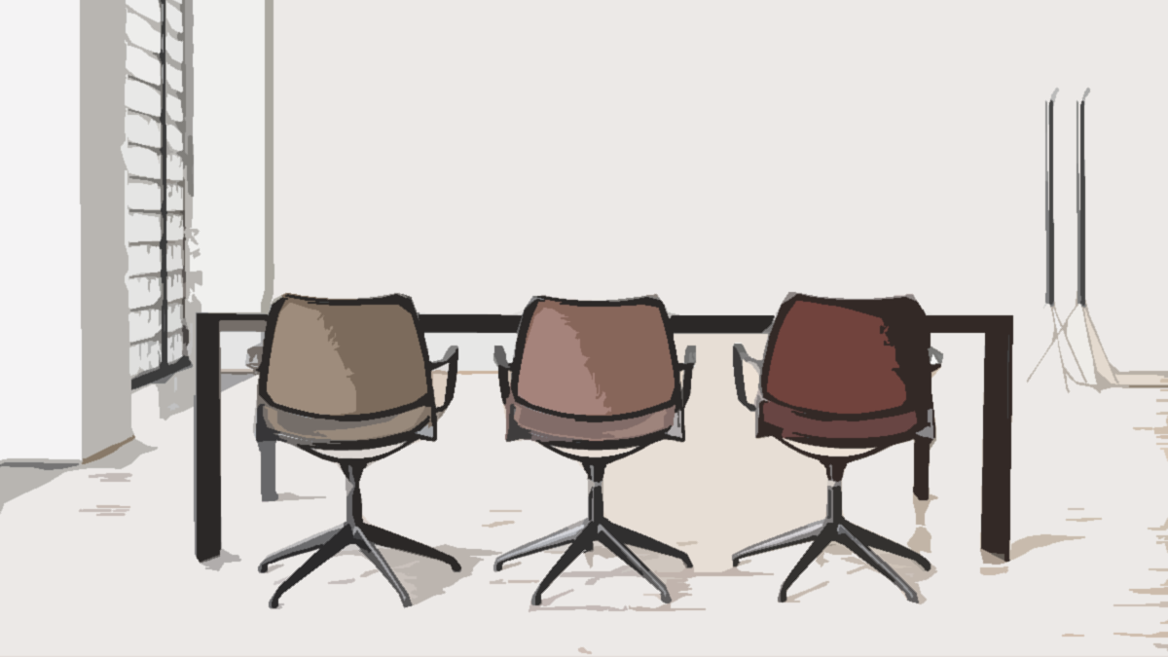
Product Design
Task 1: Create a mood board about chairs it should have at least 12 images collaged together (see sample) you need to think about different material and styles.
Try adding in a variety of adjectives when doing your research. Adding “weird” or “interesting” or “colourful” before your search will change the results.

Slide 4
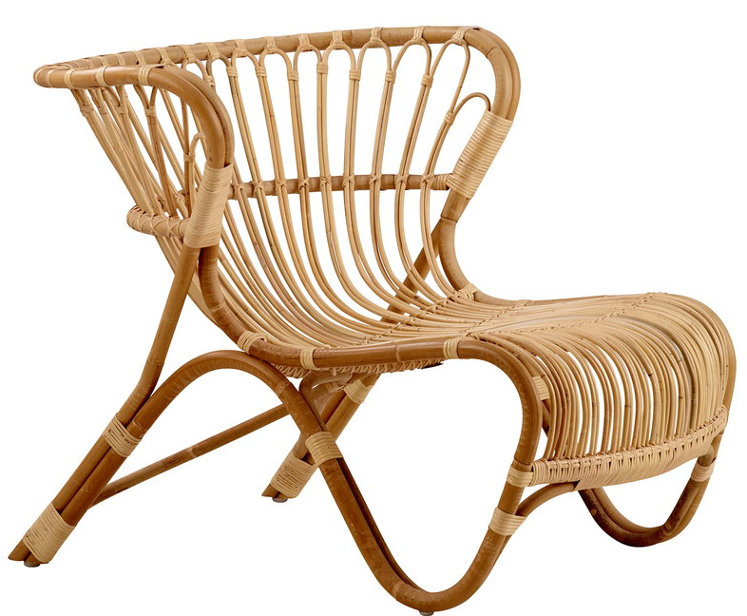
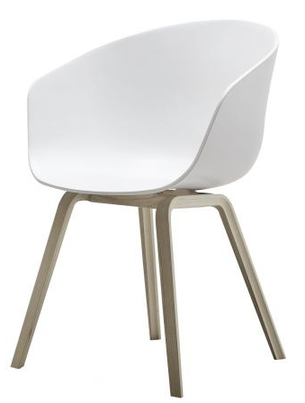
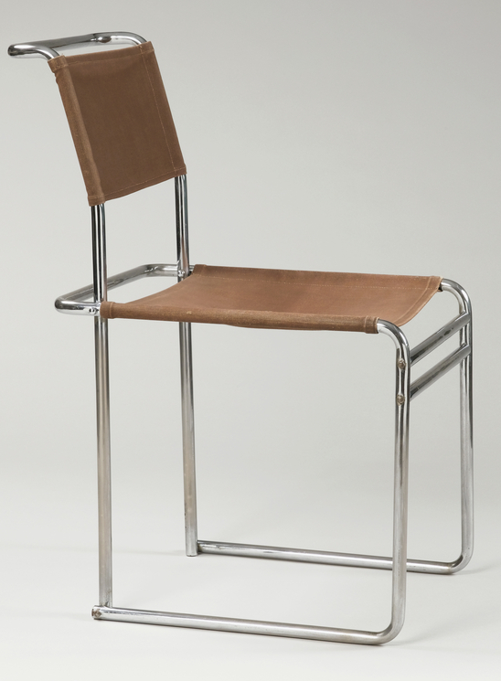
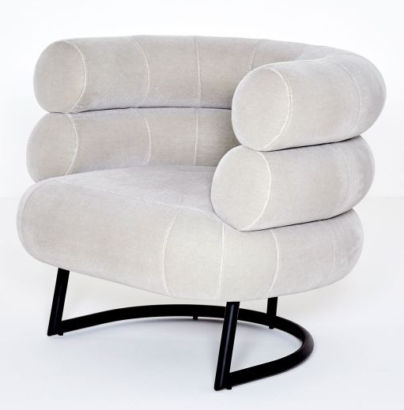
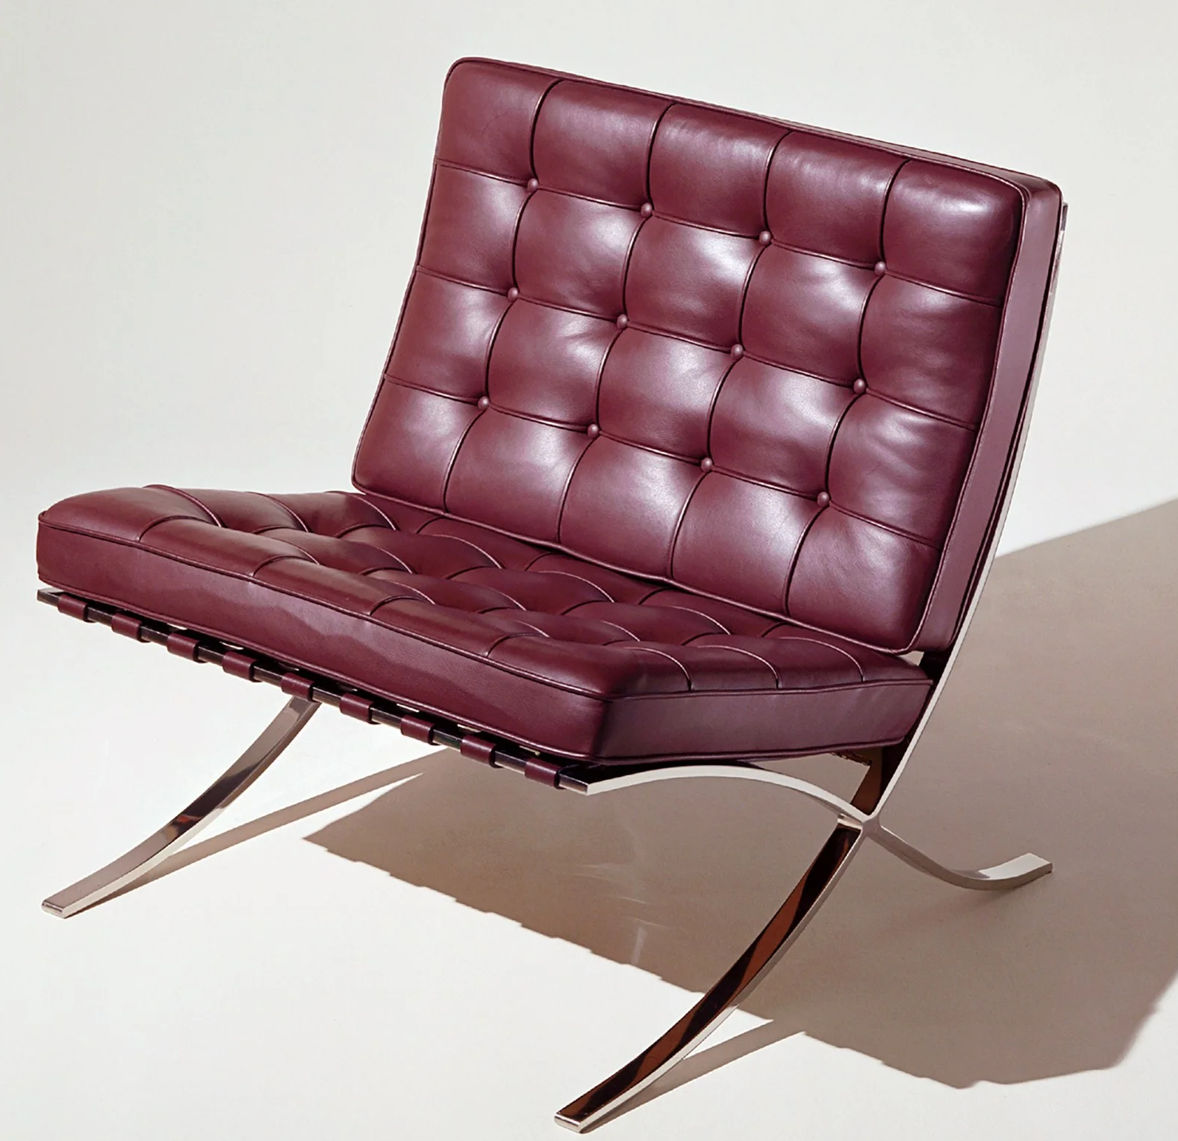
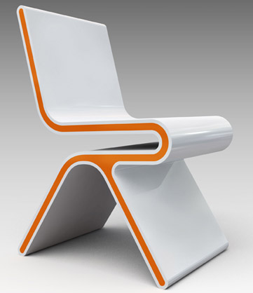
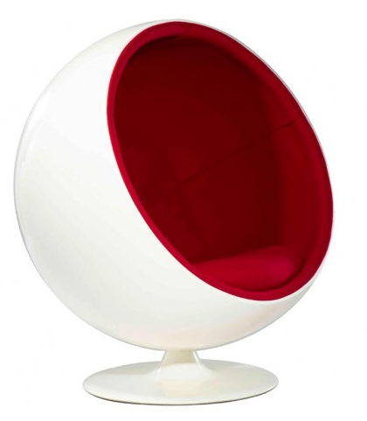
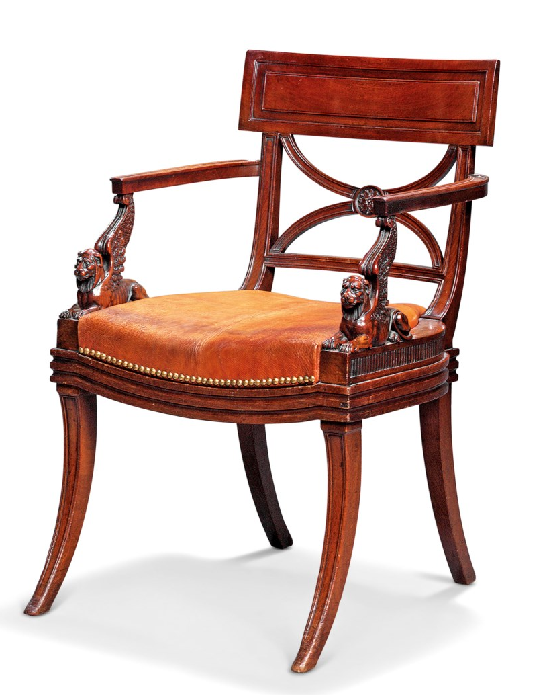
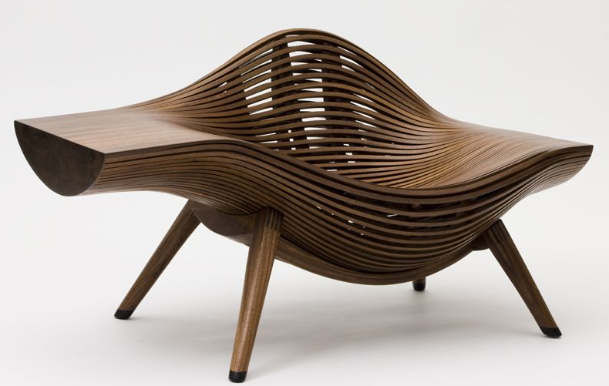
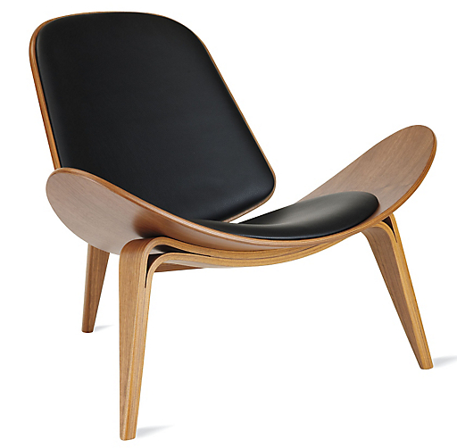
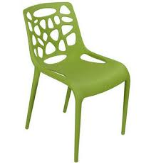
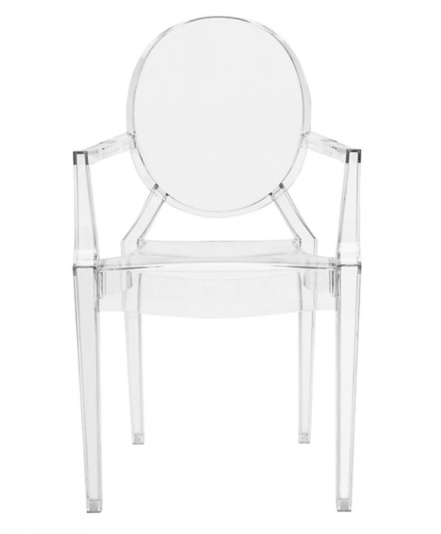
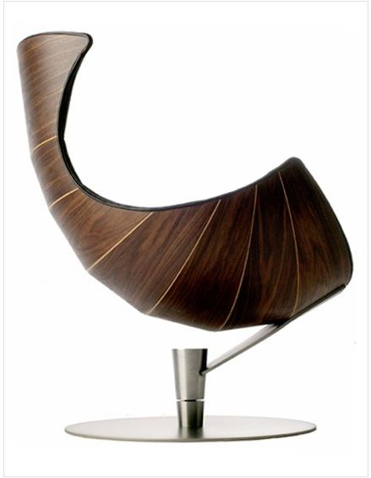
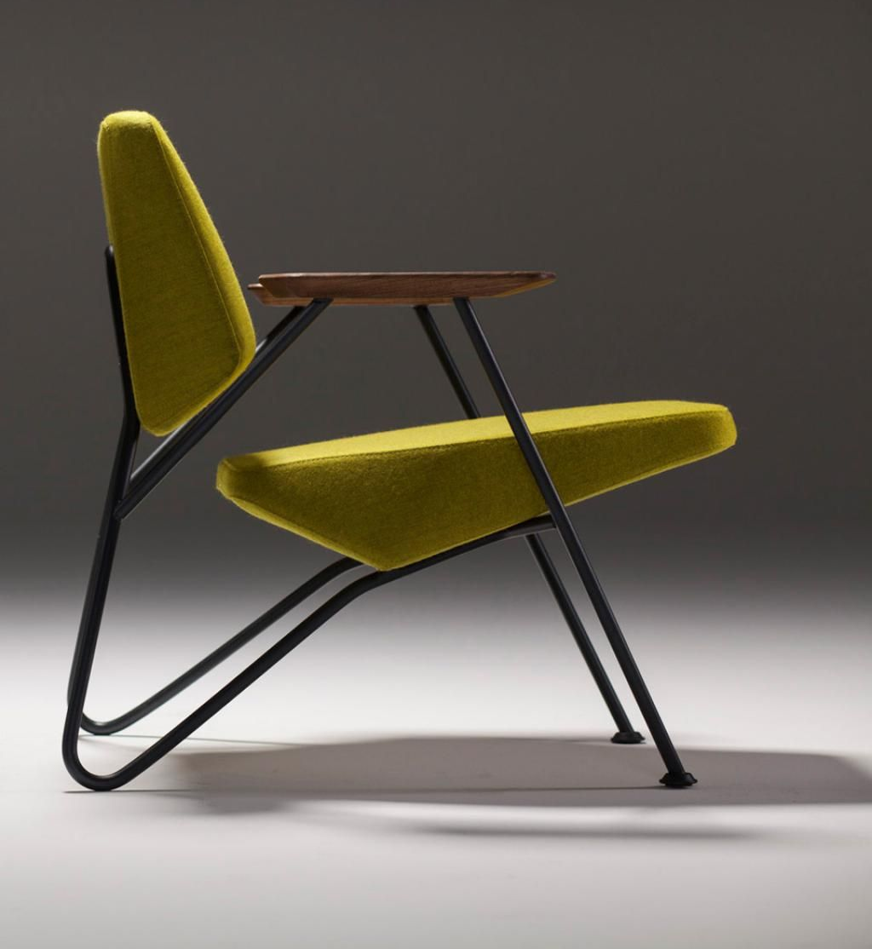
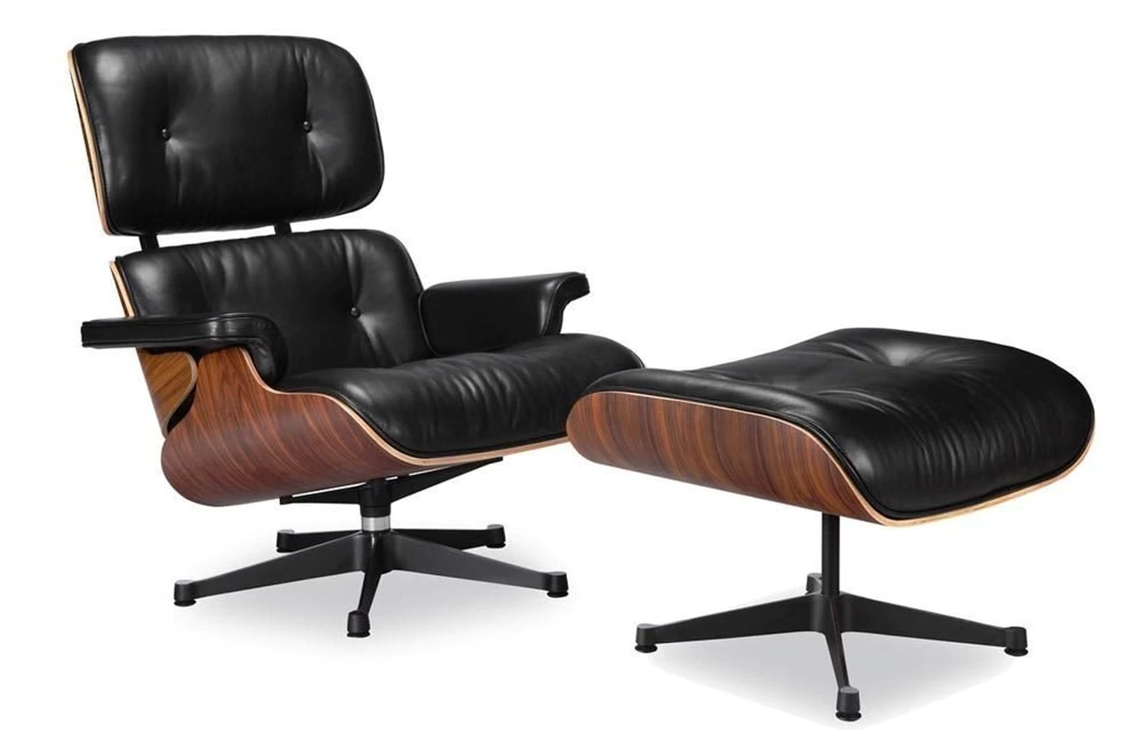
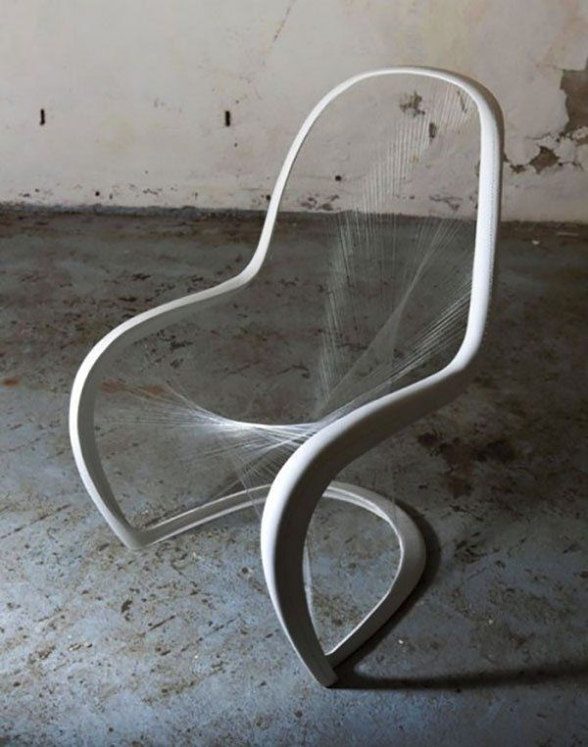
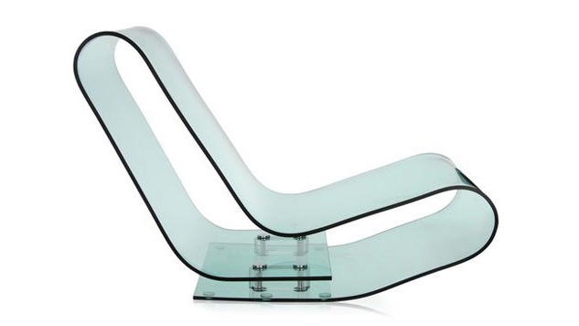
Chair Design

Slide 5
Moodboard

Slide 6
Product Design
Task 2: Iconic Designs. Some chair designs are the most iconic designs that have existed. Evaluate the chair on the next page in as much detail as possible relating to the main points of ACCESS FMM.
Aesthetics – The looks of the product, is there a particular style being used? Colour, form etc
Cost – Evaluate the effect of the cost, does this show who it is aimed at. Is it affordable etc
Customer – What does the client need? How would this product fit their needs/wants? What do they like/dislike about it.
Environment – The environment in terms of sustainability and recycling. Can the item be disassembled or maintained? Also refers to the environment in which the product will be stored/used etc.
Size – What are the dimensions of the product? Could they be changed? Why is the product that size? How have anthropometrics been used in creating the design?
Safety – Sharp edges, heavy weights? How can the product be made safer for “target market”
Function – What is the function of the product? Does it work well? How could its function be improved? How could you use the function in your own design?
Materials – What materials have been used? Why those materials? Discuss the properties of the materials and potential alternatives.
Manufacture – What methods of manufacture have been used to produce the product? Could it be made more efficiently using a different method? What are the effects of the method of production that they have used e.g. vacuum formed products are hollow.

Slide 7
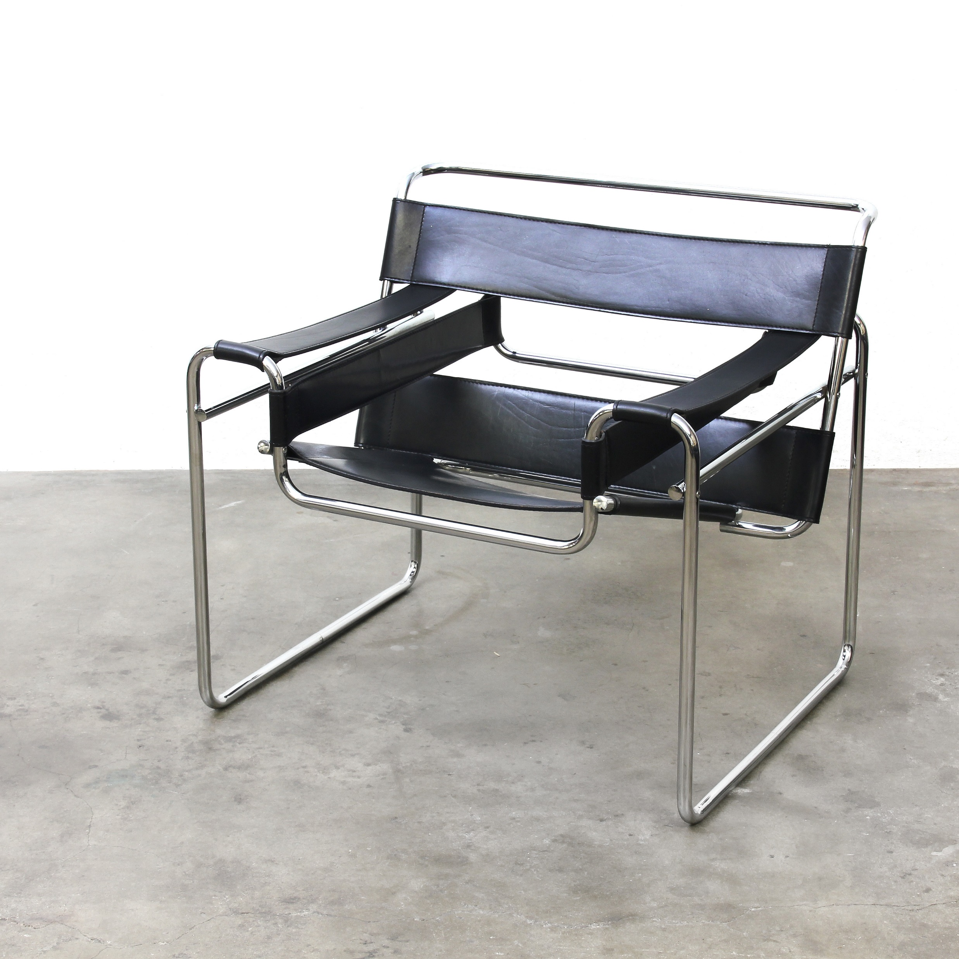
Wassily B3 Chair - https://www.knoll.com/product/wassily-chair, https://www.moma.org/collection/works/2851

Slide 8
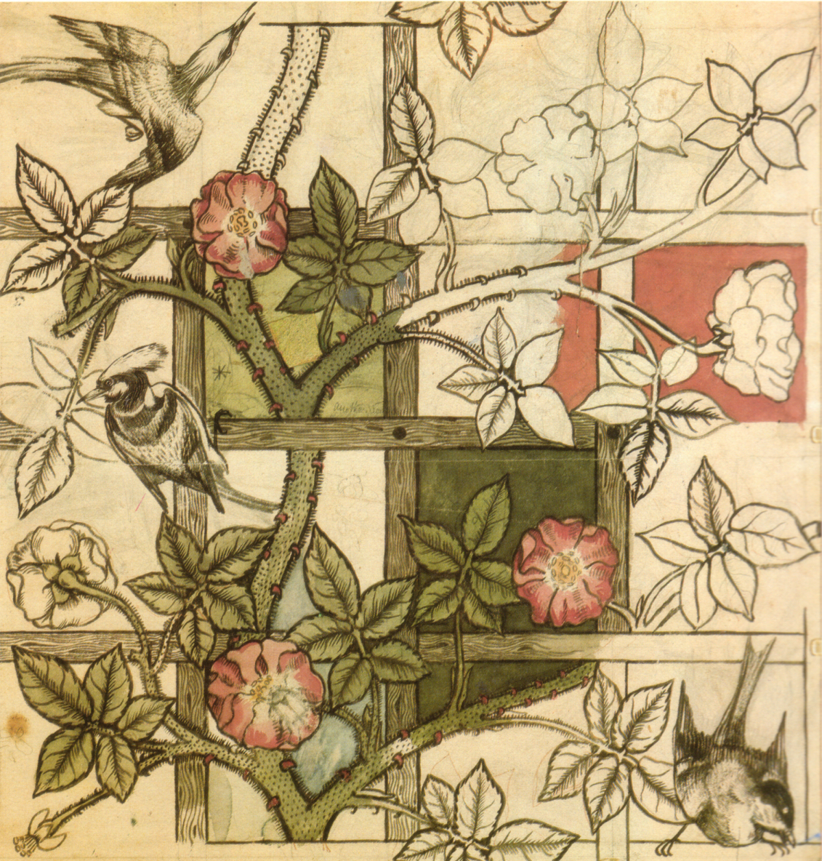
Product Design
Task 3: Famous design movements. There has been dozens of design movements over the last hundred years and most contain a different set of styles and principles which they strived to achieve. From the list below have a look at each design movement briefly (we have already covered Memphis this year). In the space on the next page research into that design movement.
Research Content:
Images of products designed in that style.
What you like and dislike about the design movement. Why did you choose this one?
Who are the key designers in this design movement and can you find a famous product they designed?
List the key common traits about things in your design movement (E.g. for Memphis; bright colours, asymmetrical shapes, form over function)
Can you find any reasons why this design movement started? (E.g. Art deco is a reflection of attitude post world war one. Opulence and uses of new materials discovered or invented during the war.)
Design Movements:
Arts and Crafts
Art Deco
Art Nouveau
Pop Art
Bauhaus
De Stijl

Slide 9
Research

Slide 10
Product Design
Task 4: From your research you needs to start creating 3+ sketches of your own design for a new chair to follow the theme of your chosen design movement. Work on paper or on your iPad. Drawings should be placed on the next page (Use your camera to take a photo).
Think about the drawing skills you have used previously this term in terms of presentation techniques, style, fine lining etc

Slide 11
Initial
Ideas

Slide 12
Product Design
Task 5: Adapt and develop. Using your research and previous drawings to complete 3+ designs for a picnic area/table/bench in a school that uses influence from the design movement you have chosen. Use the next page to present your work.
When done you should render your designs and try to show a backdrop of a likely area like a school field or courtyard.

Slide 13
Development

Slide 14
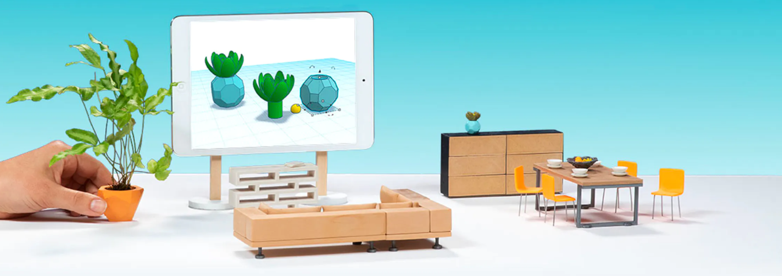
Product Design
Task 6: Work through the TinkerCAD tutorial using the link above. Post evidence of some of the stages on the next page.
Extension: Follow the animal tutorial to make an animal of your choice.
https://www.tinkercad.com/
Tutorials:
https://www.youtube.com/watch?v=60xfIu-lqAs
https://www.youtube.com/watch?v=GcD0vKjoUyg

Slide 15
CAD
Tutorial

Slide 16
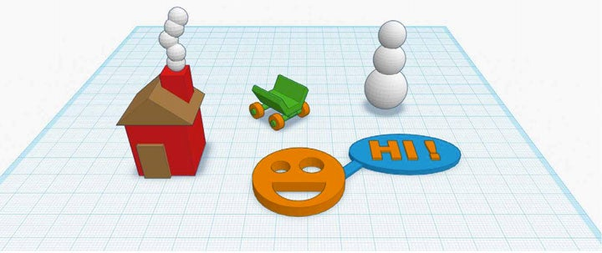
Product Design
Task 7: Use TinkerCAD to create some of the designs that you have created in your initial ideas and development work. Present these designs on the next slide. Use PowerPoint to try and remove the background to add vignettes/outer glows etc.
Advanced tutorials: https://www.youtube.com/watch?v=qaCCji-nLVc, https://www.youtube.com/watch?v=2JFxtUIOnEI&list=PL90LC6zq_Lzf9tHyFPzX_9OA35BFTfEBs
https://www.tinkercad.com/

Slide 17
CAD
Designs

Slide 18
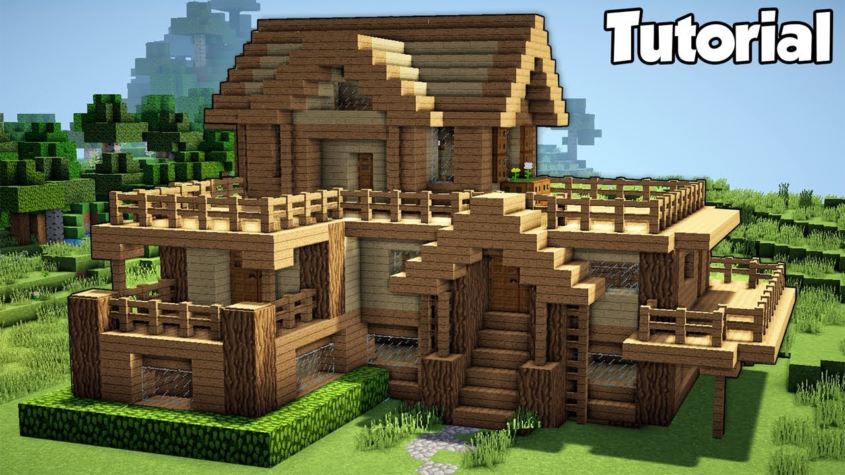
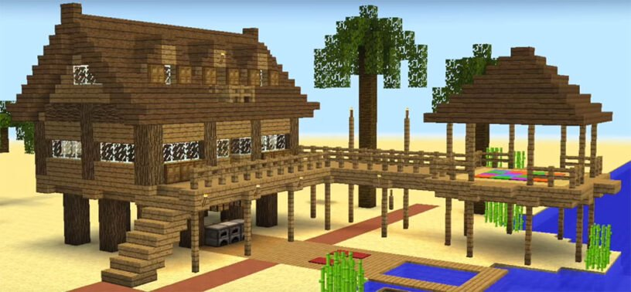
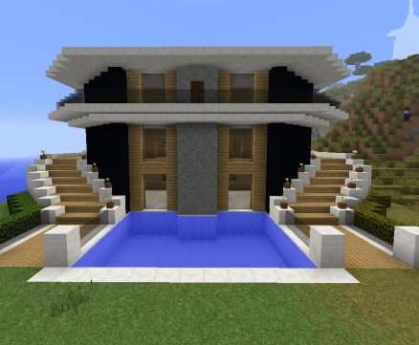
Product Design
Task 8 (Two lessons) – VR is another tool in the modern product designers toolkit. Create a virtual living space using Minecraft. Screenshot the various areas of the space and think about how you can use materials to create contrast and provide a functional or aesthetic living area. Screen shot and place your two living areas or buildings on the next page.
Extension: Try to do all of this work in survival mode.
There is a free education edition on the app store or you can find a browser version on a PC if you do not already own the program.
Tutorials: https://www.youtube.com/results?search_query=minecraft+tutorial

Slide 19
Functional
Space

Slide 20
Aesthetic
Space

