Slide 1
Year 9: Sustainability and Upcycling
Download this powerpoint and work on it directly. Reupload it to your classes Google Classroom (info on next slide). The best work will receive a prize at the beginning of the next term.

Slide 2
Year 9: Google Classrooms
Class | Class Code
9-1 | ejcthv5
9-2 | 6vo6jee
9-3 | ljjfbhk
9-4 | vixbr62
9-5 | azk7kka
9ST

Slide 3
Sustainability – Watch this short video on the principles of sustainability in our society.
https://www.youtube.com/watch?v=_5r4loXPyx8
Task 1: Reflection
Task 2: Reflection
How do you contribute to sustainable living in your home?
In your school?
What could you do to be better at living sustainably at home?
In your school?

Slide 4
Upcycling
Upcycling is a current trend and can be seen as a fashion statement in some homes. Upcycling is when a product is taken at the end of its intended lifespan and turned into a new product with a new use.
Please watch this YouTube clip to give you some ideas and inspiration. https://www.youtube.com/watch?v=fGqfWvm4TnQ
Task 3: There are some fantastic and useful examples on the internet. Create a mood board in the space below showing your favourite upcycled ideas and designs. Annotate your thoughts and feelings on the designs as you go. Try to provide thoughtful and evaluative comments on the designs.

Slide 5
Upcycling
Upcycling is a current trend and can be seen as a fashion statement in some homes. Upcycling is when a product is taken at the end of its intended lifespan and turned into a new product with a new use.
Task 4: You will need to think creatively about the objects in your home and around you. Gather used items that you could use for upcycling in your home e.g. drinks cans, glass jars, cereal containers etc
Take a picture(s) of these objects and place them below. On the next page draw some designs for upcycling these objects. These can be done using paper or your iPad (take a picture of your work to include on the next page if you are hand drawing). Feel free to label the objects so it is easier to understand the original object and its new use. These designs could be coloured and rendered if you have the available materials with you.

Slide 6
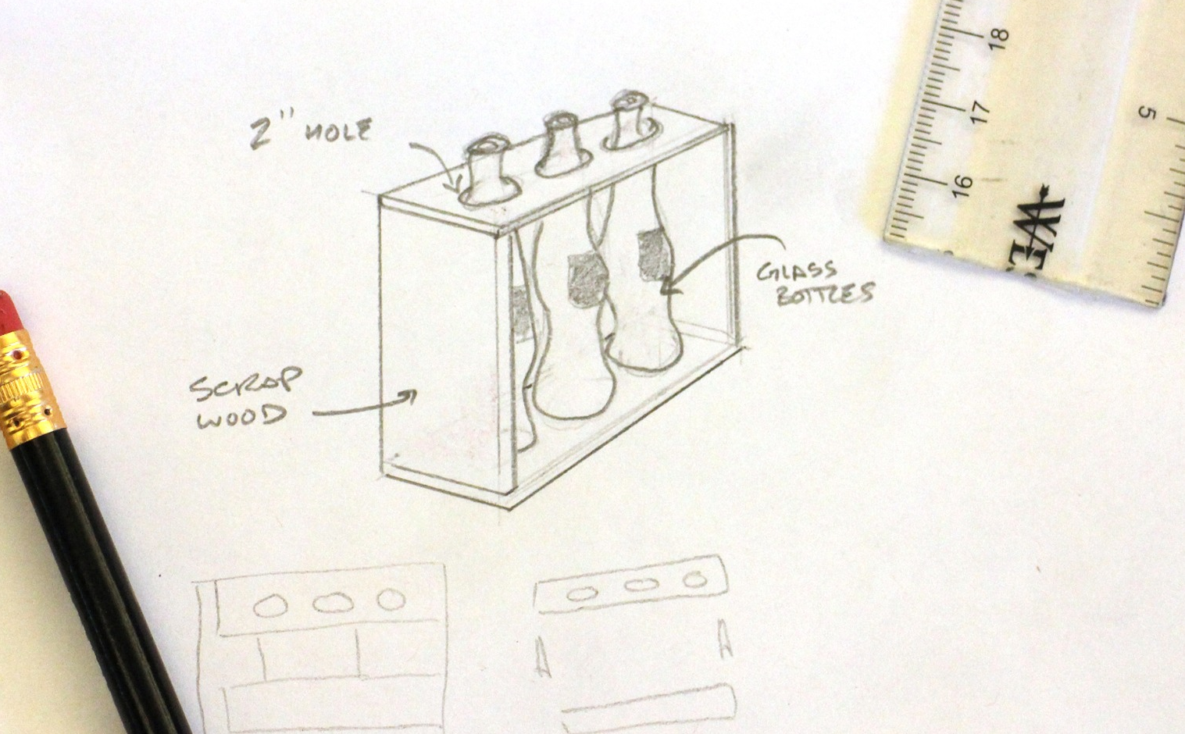
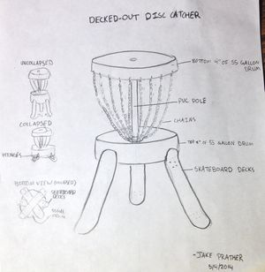
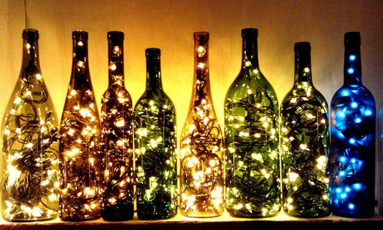
Upcycling
Designs

Slide 7
Upcycling
Upcycling is a current trend and can be seen as a fashion statement in some homes. Upcycling is when a product is taken at the end of its intended lifespan and turned into a new product with a new use.
Task 5: As a designer we must be constantly evaluating and analysing our work to make sure that what we are producing is of the best quality possible. We often do this through annotating and placing our thoughts on a page.
Either redraw, take a picture or copy and paste three of your designs in the space below. Use the annotation help sheet on the next page to fully evaluate and annotate these three designs. Suggest improvements to the design that you originally had.

Slide 8
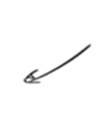
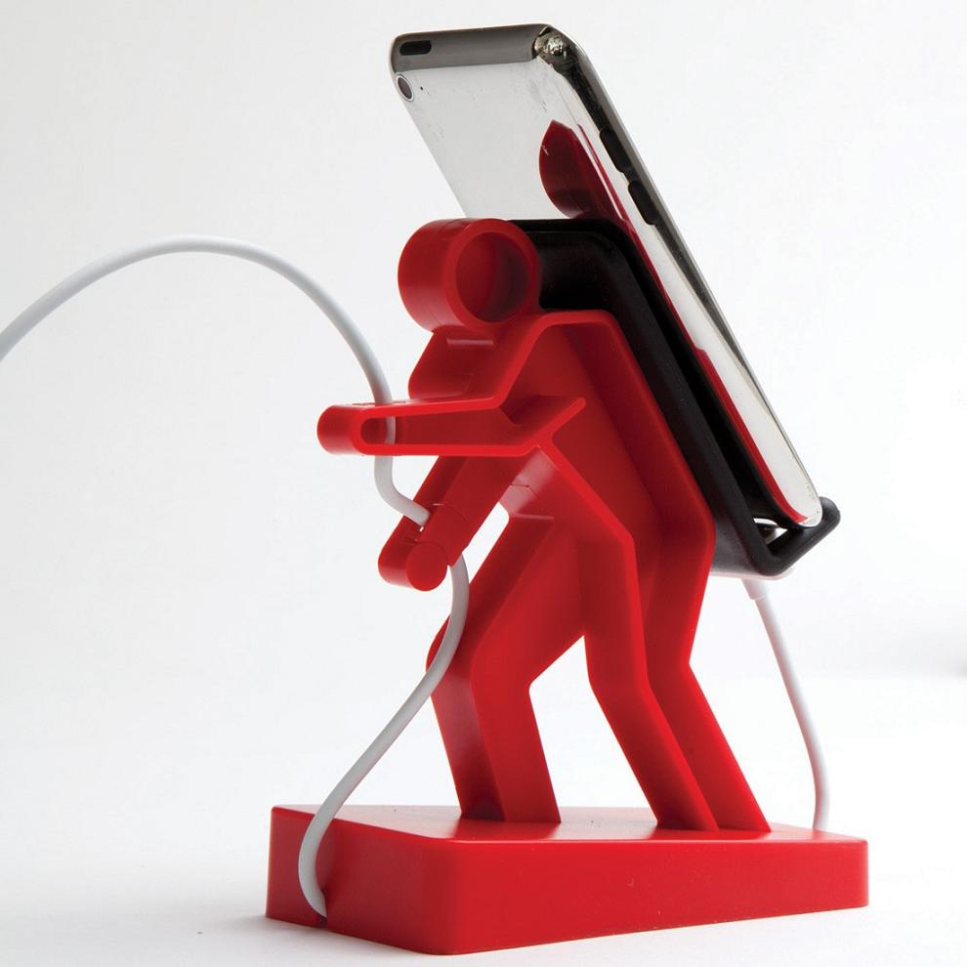
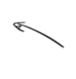
How to annotate a design idea
Your design idea drawings do not always give the reader all the details you have thought about, by adding annotation you can share your whole idea and give details about areas you can’t see.
Key Language in red
Will this product be safe?
How can you test this?
Add size and Dimension information
What Materials will be used and why?
What colours are you going to use?
What is the purpose of the product? Is this an effective product (does it meet the requirements of the Brief and Specification?)
What is the Environmental Impact of the product? (recycled materials? could it be recycled after use?
Do you think this is a good design?
Good points and bad points
What is the cost of the materials required if known?
Is it Ergonomic?
How does/ will a human use it
How could it be made?

Slide 9
Upcycling
Upcycling is a current trend and can be seen as a fashion statement in some homes. Upcycling is when a product is taken at the end of its intended lifespan and turned into a new product with a new use.
Task 6: Create a poster using the 6R’s of sustainability. For each point of the 6R’s illustrate it with an image of a product that shows this principle. Place this work on the next page.
Reduce
is it possible to reduce the amount of materials used?
Rethink
is there a better way to solve this problem that is less damaging to the environment?
Refuse
not accepting things that are not the best option for the environment. For example, is the packaging really needed?
Recycle
could recycled materials be used, or is the product made from materials that are easy to recycle?
Repair
is the product easy to repair?
Reuse
could the product have another use? Could its parts be used in other products? This will extend its life.

Slide 10
6Rs
Poster

Slide 11
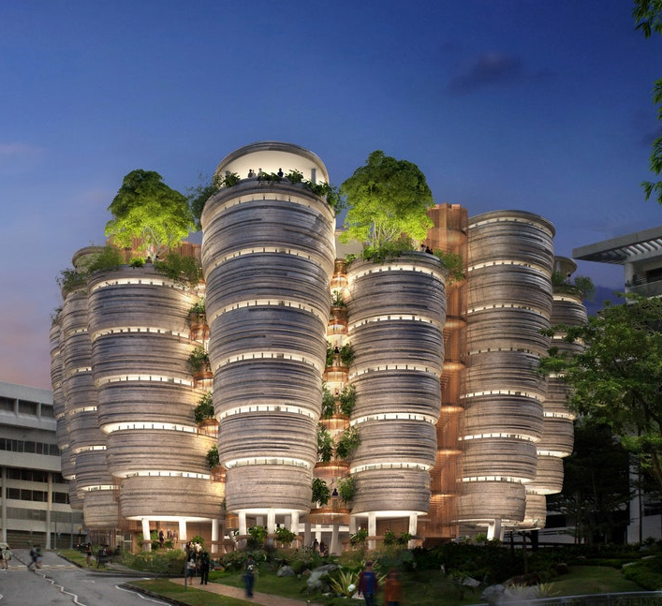
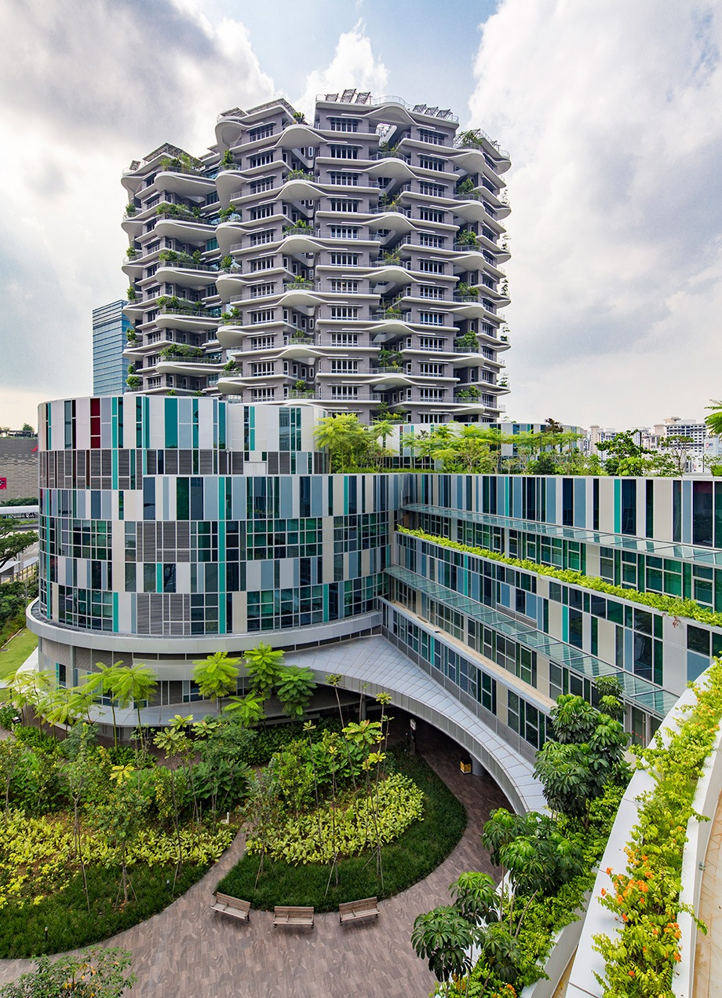
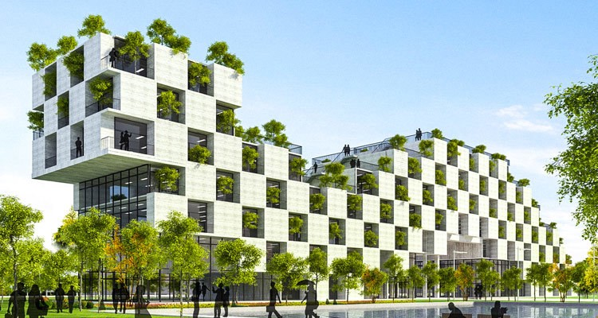
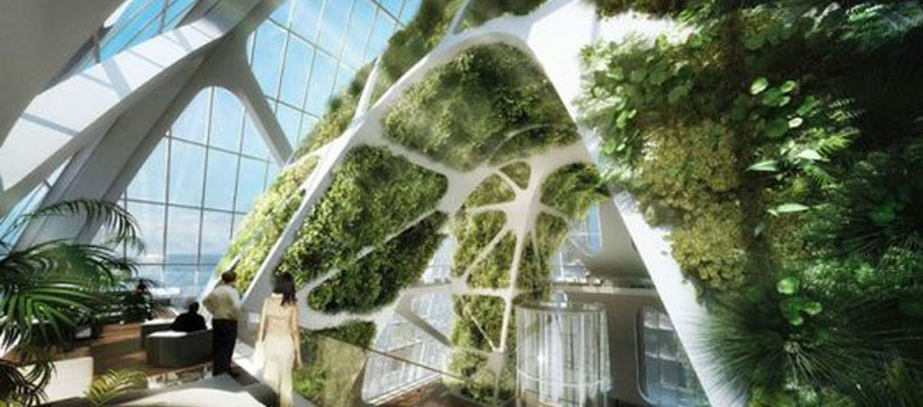
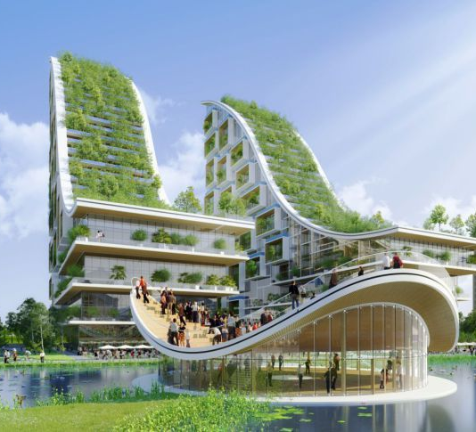
Sustainability
Upcycling is a current trend and can be seen as a fashion statement in some homes. Upcycling is when a product is taken at the end of its intended lifespan and turned into a new product with a new use.
Task 7 (2 Lessons): Green areas are going to become a key factor in communities in the future and this could be especially prevalent in the design of modern buildings.
Watch this YouTube clip of sustainable houses from Grand Design. https://www.youtube.com/watch?v=i7z9_oneirU
Use this as inspiration to begin the design of a sustainable home.
What are the areas which are key to a house? Write below.
On the next page create a series of plan drawings (Top down) for your house design. You could make it all one floor like a bungalow or work on multiple floors. If this is the case label each floor clearly. This can be done using the iPad or on paper.
Make sure to highlight green areas and how you have been sustainable through use of materials etc

Slide 12
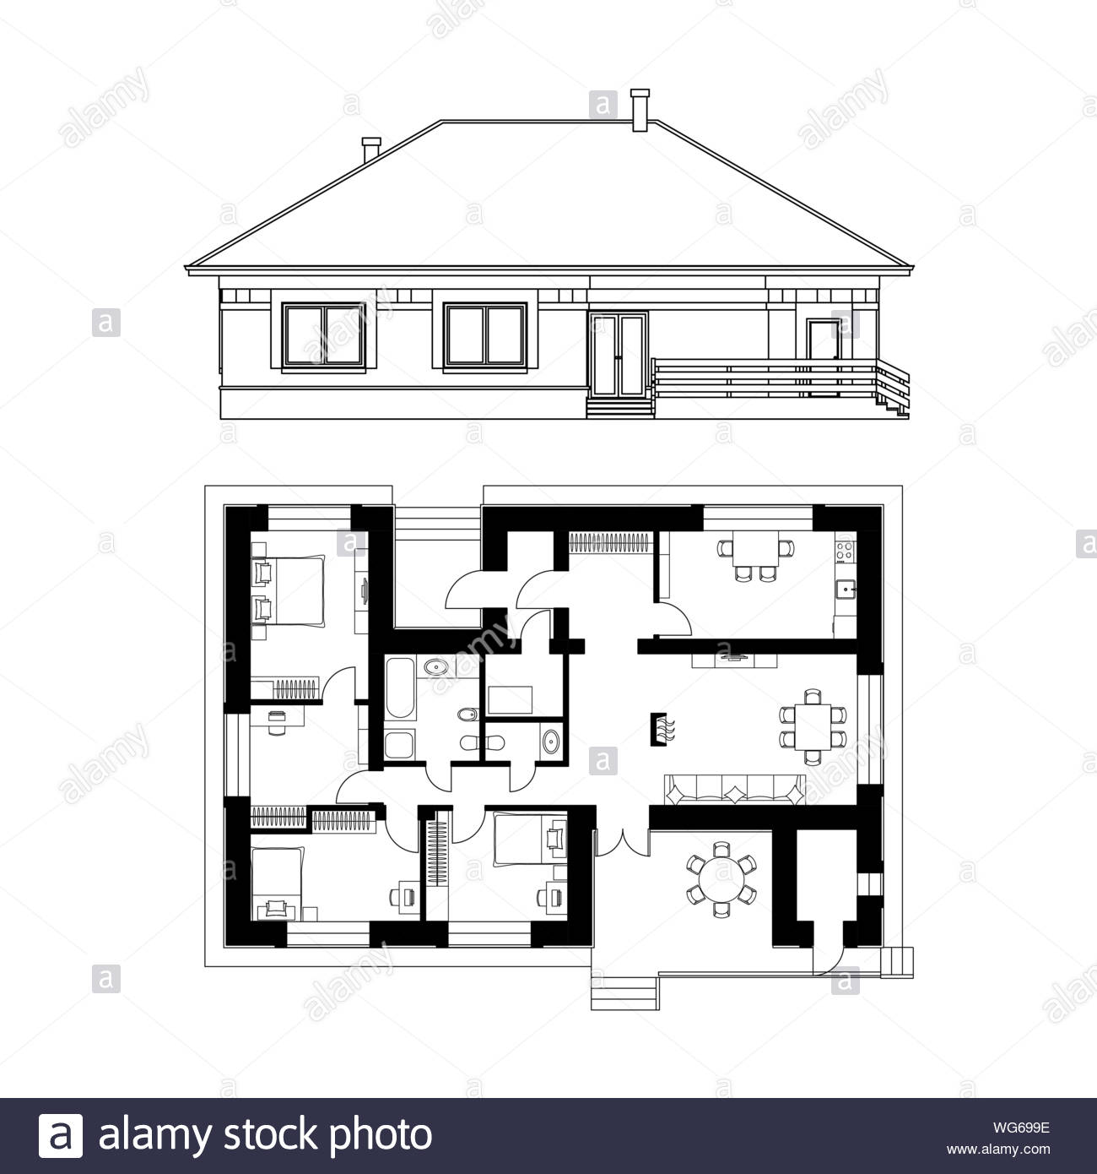
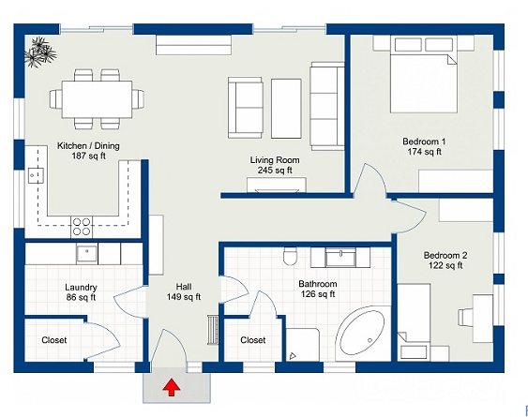
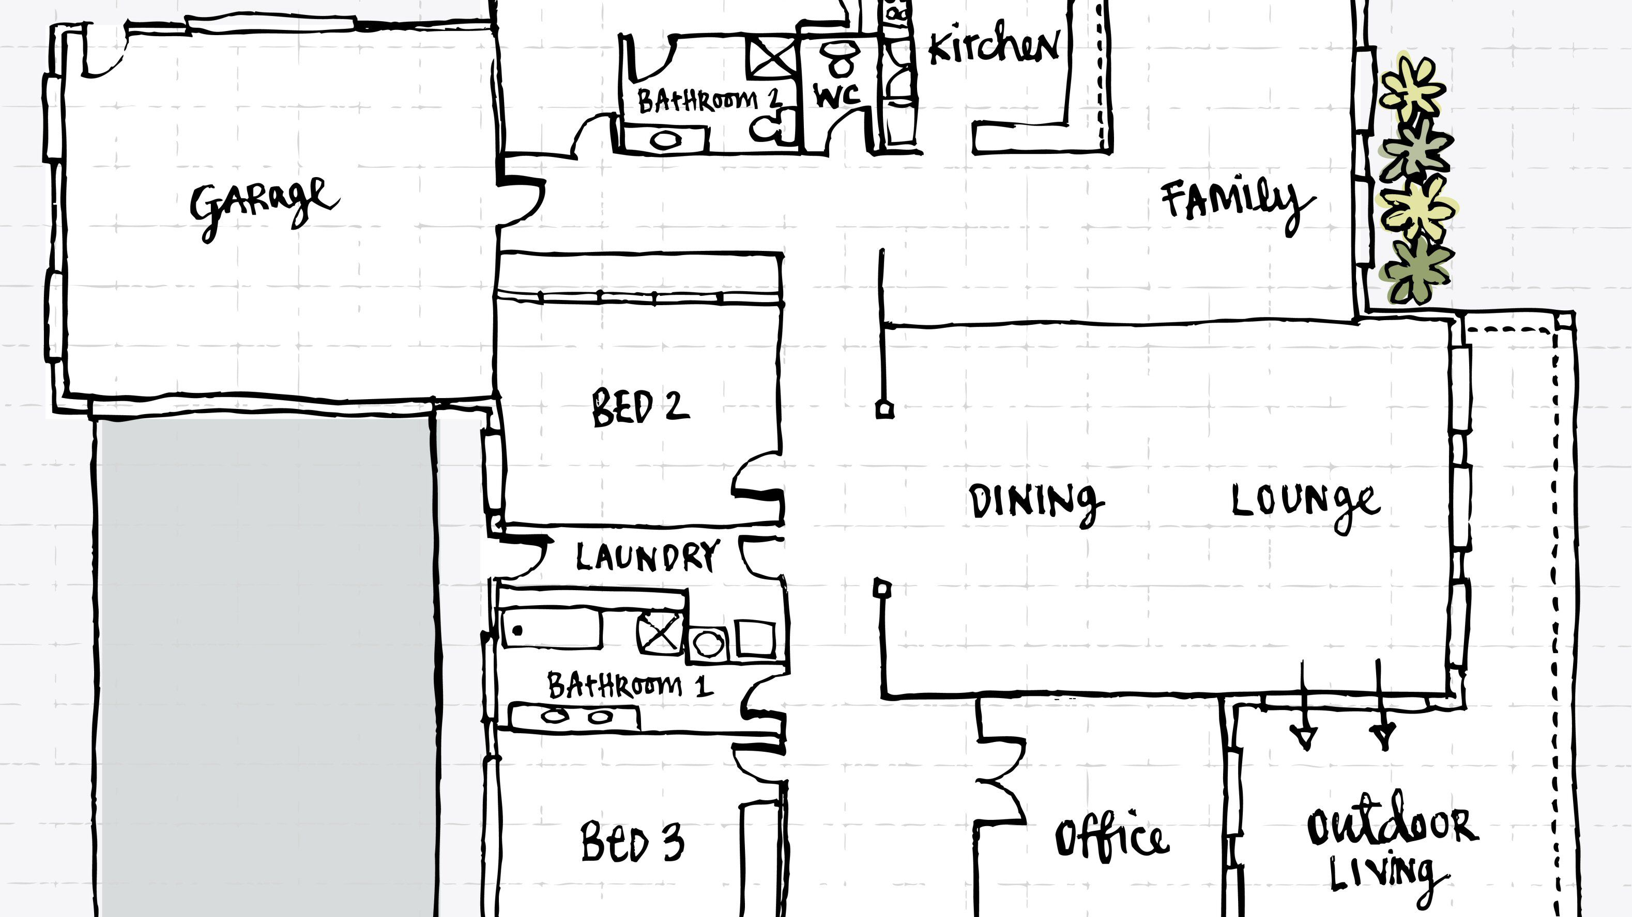
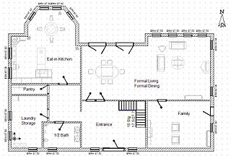
Plan Drawing Examples

Slide 13
Plan D rawings

Slide 14
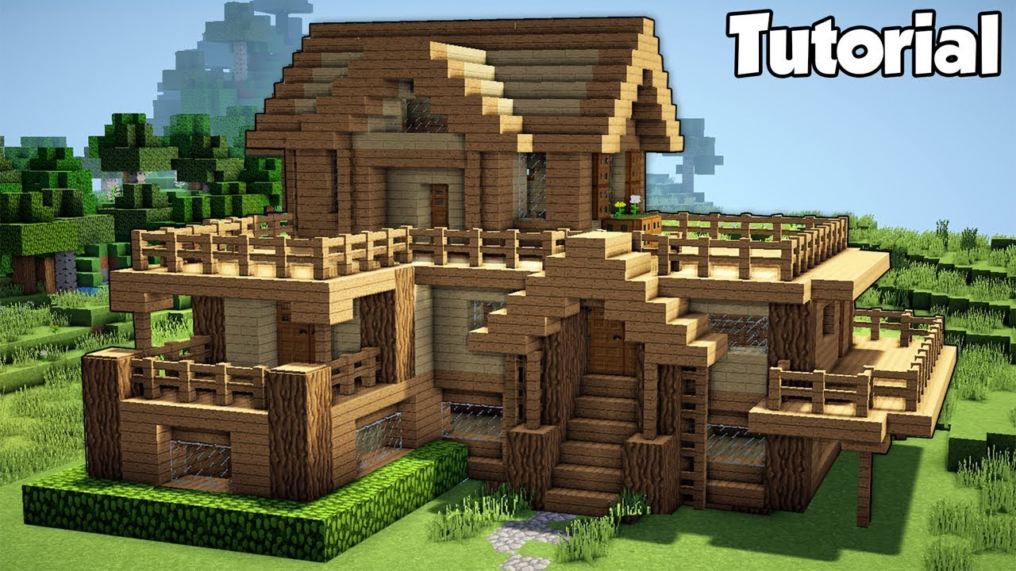
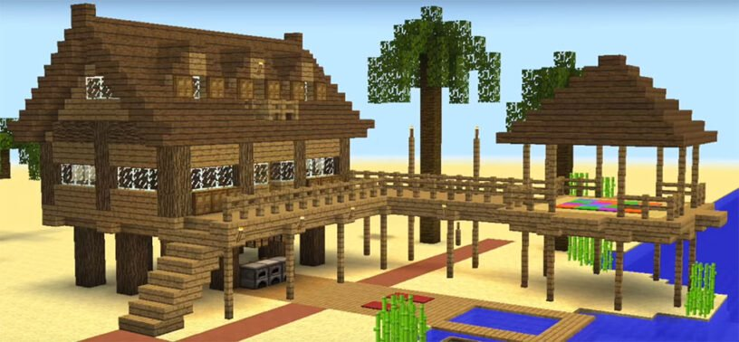
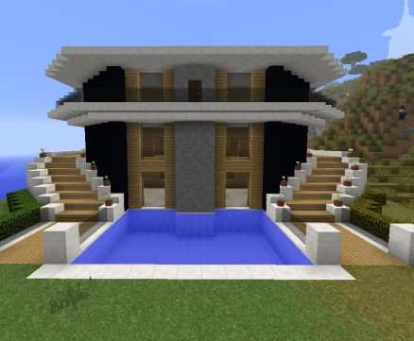
Sustainability
Task 8 (Two lessons) – VR is another tool in the modern product designers toolkit. Create your house design using Minecraft. Screenshot the various areas of the space and think about how you can use materials to create contrast and provide a sustainable house.
Screen shot and record the build over the next few pages. Explain what you have done at each stage.
Extension: Try to do all of this work in survival mode.
There is a free education edition on the app store or you can find a browser version on a PC if you do not already own the program.
Tutorials: https://www.youtube.com/results?search_query=minecraft+tutorial

Slide 15
Housing
Build
Record

Slide 16
Housing
Build
Record

Slide 17
Completed
House

