Slide 1
Year 8 Earphone Wrap:
Remote Learning
Download this powerpoint and work on it directly. Reupload it when complete to the correct Google Classroom (Info is on the next slide). Prizes will be awarded for the best work when you return to school.

Slide 2
Year 8
Google Classroom Codes
Class | Class Code
8-1 | vdfjbzg
8-2 | ffs2iss
8-3 | scuajeb
8-4 | ditjcd3
8-5 | ggbtvgy
8-6 | 2723ofn
8-7 | 2qcs4vm
8HM | 5ycvjih

Slide 3
Project
Earphone wrap
Task 1: Task analysis. Young adults often listen to music or watch videos from a mobile phone or tablet especially ‘on the move’. Using your knowledge of listening to music in this way as inspiration create a design for keeping trailing wires safe and stored.
Use the space below to develop your thoughts.
Music ‘on the move’
What?
Why?
Where
How?
Who?
When?

Slide 4
Research
Images of relevant products to the context with notes
Task 2: Mood board. Collect a variety of images and ideas that could help you. This could vary from music equipment and earphone styles as well as shapes that wires could be wrapped around. Add notes to explain and organise you thoughts on the images.

Slide 5
Design Brief
Write a design brief for your project
Task 3: Design Brief (What do you intend to do in this project to meet the needs of the client or user)
Example sentences:
I am going to design and make __________________________________.
(Insert target market) needs this because _____________________________________________________________________________________________________________________________________________________.
My design must ___________________________ because _____________________.
I will use the colours ____________________ in my work because ______________.

Slide 6
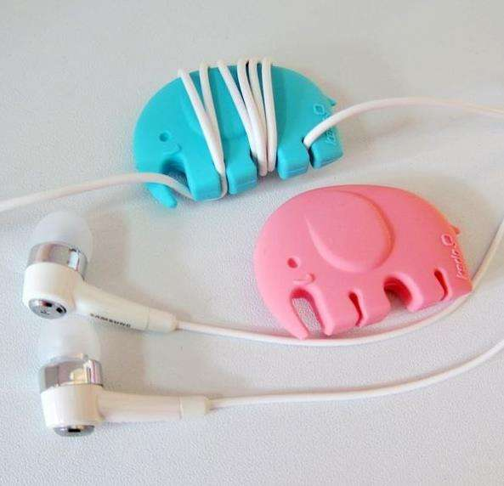
Product Analysis
Choose a product from the internet and analyse it
Task 4: Product Evaluation. Analyse the earphone wrap in the centre of the page. There are categories in which you should be mainly looking at listed. Try to be as impartial as possible except in the opinion box.
Style/Looks (Aesthetics)
Materials
Durability
Cost
Opinion
Safety
Environment
Target Market

Slide 7
Design Ideas
Task 5: Initial Ideas. Use an app on your iPad or pencil and paper (take a picture and attach). Create a page of initial ideas (6 designs minimum) for your earphone wrap design. Use the annotation help sheet on the next page to help you evaluate the design. Render your designs (Colour to look like the material it is made from).

Slide 8
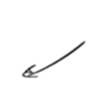
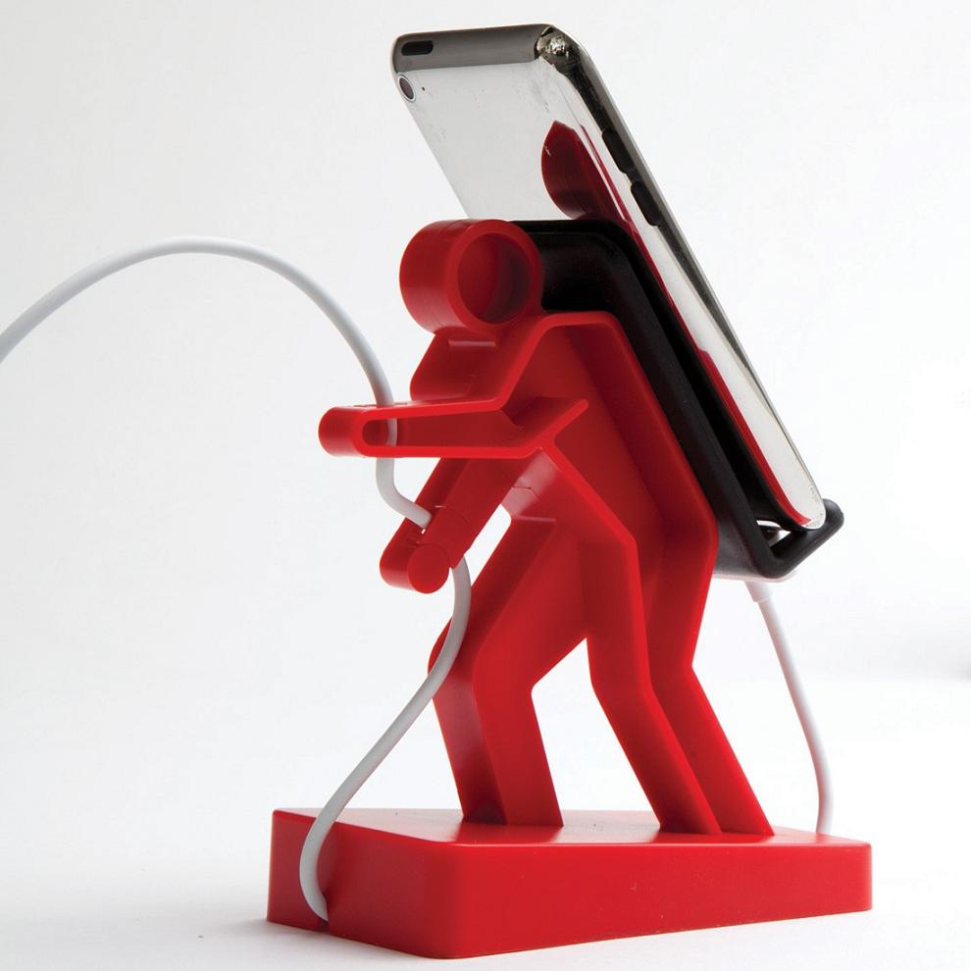
How to annotate a design idea
Your design idea drawings do not always give the reader all the details you have thought about, by adding annotation you can share your whole idea and give details about areas you can’t see.
Key Language in red
Will this product be safe?
How can you test this?
Add size and Dimension information
What Materials will be used and why?
What colours are you going to use?
What is the purpose of the product? Is this an effective product (does it meet the requirements of the Brief and Specification?)
What is the Environmental Impact of the product? (recycled materials? could it be recycled after use?
Do you think this is a good design?
Good points and bad points
What is the cost of the materials required if known?
Is it Ergonomic?
How does/ will a human use it
How could it be made?

Slide 9
Packaging Ideas
Task 6: Packaging mood board and analysis. Use the space below to find examples of blister packaging and other packaging designs out there. Think of the main components required by packaging and that you can see on most packaging. On the next page complete a design for your earphone wrap packaging. Don’t forget to include the main features you have identified.
Main Features of Packaging

Slide 10
Packaging
Front Design:
Back Design:

Slide 11
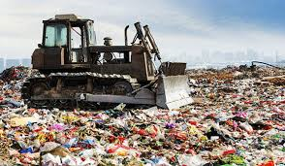
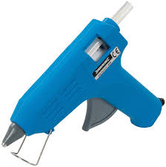
Polymers
The hot glue gun
https://www.youtube.com/watch?v=f3BjWvTT9Ro
https://www.youtube.com/watch?v=_6xlNyWPpB8
Task 7: Watch the two YouTube links about plastic production and the lifecycle of plastic.
Polyethylene or polythene is the most common plastic, with around 80 million tonnes being produced annually. Its primary use is in packaging (plastic bags, and films as well as containers including bottles, etc.). There are many kinds of polyethylene with different melting points. Polyethylene is a thermoplastic. Polyethylene is not easily biodegradable, and so accumulates in landfills.
We are using Polyethylene with a melting point of between 85°C to 150°C
Challenge: Give 2 examples of how consumers can avoid contributing to plastic being put into landfill.
Hot-melt adhesive (HMA)
Hot melt adhesive, also known as hot glue, is a form of thermoplastic adhesive that is commonly sold as solid cylindrical sticks of various diameters designed to be applied using a hot glue gun. The gun uses a continuous heating element to melt the plastic glue, which the user pushes through the gun with a mechanical trigger mechanism on the gun. The glue squeezed out of the heated nozzle is initially hot enough to burn and even blister skin. The glue is tacky when hot, and solidifies in a few seconds to one minute.
Extension: State 3 safety points for use of a hot glue gun.

Slide 12
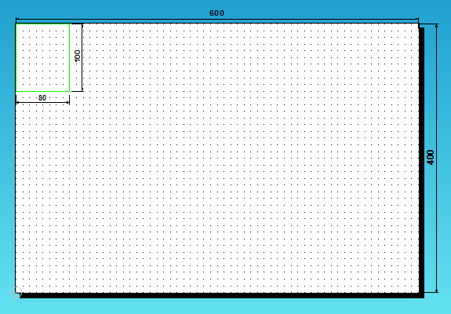
Earphone Wrap
Maths based questions
Task 8: Maths Tasks
Core: Assuming there is at least a 10mm gap between each earphone wrap. How many earphone wrap templates can we fit on the laser cutter at once?
Core: What is the area of one earphone wrap template?
Challenge: Using your total from the previous question calculate the total area of the acrylic that will be thrown away after the earphone wrap templates have been taken out.
Area = Height x Width
Core: Each set of earphone wrap templates cut on the laser cutter use a sheet of acrylic 600mm x 400mm.
This costs £6.23 per sheet and produces 50 earphone wraps.
What is the cost of each template?

Slide 13
Earphone Wrap
Maths based questions
Task 9: Maths
Core: This is not all the material cost as the hot melt adhesive (HMA) costs:-
12p per glitter glue stick
8p per plain coloured glue stick
It is estimated that each earphone wrap uses half a glue stick each time.
How many glue sticks would you need to make the 50 earphone wraps you have cut out?
If you made them all out of glitter glue what would be the cost of glue used?
If you made them all out of plain coloured glue what would be the cost of glue used?
Challenge: The wastage from injection moulding is 10% of each glue stick used.
What is the cost of this waste:-
For each glitter glue stick?
For each plain coloured glue stick?

Slide 14
Manufacturing
Injection moulding
Task 10: Injection moulding is the process we are going to use to make our earphone wrap. We will be using our 2D design mould to create the shape from thermoplastic.
See injection moulding at this link: https://www.youtube.com/watch?v=b1U9W4iNDiQ
Mould
Important features of the mould are that it can be easily opened and the moulding easily ejected (taken out). All moulding cavity surfaces must be smooth and highly polished to get a good quality of finish to the moulding. Sharp corners and sudden changes in thickness should be avoided because they interrupt the flow of plastic and weaken the moulding. Large flat surfaces should be avoided because the finished moulding may not come out completely flat.
Commercial process of injection moulding
Stage 1 Granulated or powdered thermoplastic plastic is fed from a hopper into the Injection Moulding machine. Stage 2 The Injection Moulding machine consists of a hollow steel barrel, containing a rotating screw (Archemidial Screw). The screw carries the plastic along the barrel to the mould. Heaters surround the barrel and melt the plastic as it travels along. Stage 3 The screw is forced back as the melted plastic collects at the end of the barrel. Once enough plastic has collected a hydraulic ram pushes the screw forward injecting the plastic into the mould cavity. The mould is warmed before injecting and the plastic is injected quickly to prevent it from hardening before the mould is full.
Stage 4 Pressure is maintained for a short time to prevent the material creeping back during setting (hardening). This prevents shrinkage and hollows, therefore giving a better quality product. The moulding is left to cool before removing from the mould. The moulding takes on the shape of the mould cavity.
Injection Moulding machine
Make a step by step (with diagrams and notes) flow chart of the injection moulding process.

Slide 15
Design
Living Spaces
Task 11: Alessi produce a large variety of products. Look through the website to find products that you find interesting and place them below. https://www.alessi.com/gb_en/?gclid=EAIaIQobChMIh8zg6OCo6AIVwbHtCh3cuA9iEAAYASAAEgKMUfD_BwE&gclsrc=aw.ds
Use influence from the style of Alessi to design a range of products in your home. Look around your home for inspiration in the products that you can design. You can do these designs on either paper or your ipad. Place them on the next page.

Slide 16
Design
Living Spaces

Slide 17
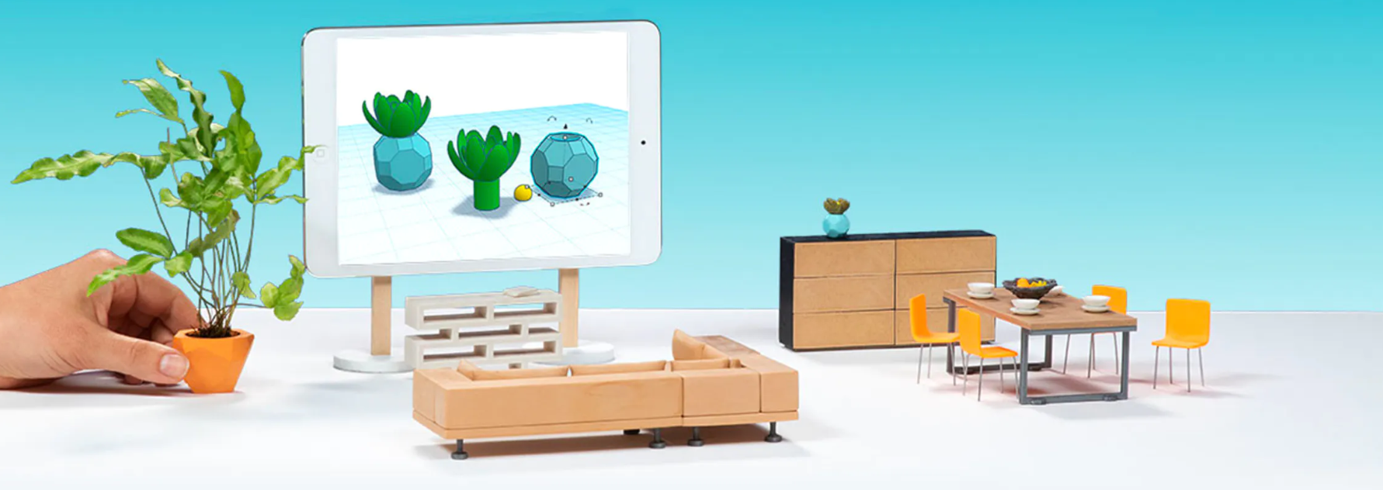
Design
Living Spaces
https://www.tinkercad.com/
Task 12: Work through the TinkerCAD tutorial using the link above. Post evidence of some of the stages on the next page.
Extension: Follow the animal tutorial to make an animal of your choice.
Tutorials:
https://www.youtube.com/watch?v=60xfIu-lqAs
https://www.youtube.com/watch?v=GcD0vKjoUyg

Slide 18
Design
Living Spaces

Slide 19
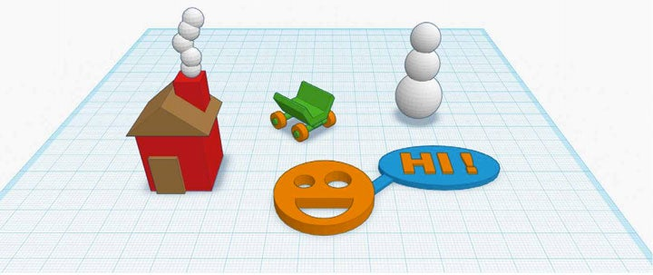
Design
Living Spaces
https://www.tinkercad.com/
Task 13: Use TinkerCAD to create some of the designs that you have created in task 11. Present these designs on the next slide.
Advanced tutorials: https://www.youtube.com/watch?v=qaCCji-nLVc, https://www.youtube.com/watch?v=2JFxtUIOnEI&list=PL90LC6zq_Lzf9tHyFPzX_9OA35BFTfEBs

Slide 20
Design
Living Spaces

